Slide 1


Progress Review 2 Event-Mate: A sustainable & Inclusive Event Management
Department of Computer Science & Engineering
CHITKARA UNIVERSITY , HIMACHAL PRADESH
Submitted To :
Mr. Rinku Saini Sir
Assistant Professor
Submitted By:
Dhruv Kumar Sharma 2411981191
Deshna Jain 2411981182
Divyanshi Thakur 2411981200
Dilpreet 2411981196
Date – 23 April , 2025 1

Slide 2
CONTENTS
SDG Goals Mapping
Problem Statement
Introduction of the project
Projective Objective
AI Chat Bot & Virtual Assistant
BMI Calculator
Personalized Calorie Calculator
Fit Hub E-Learn
Fit Hub Store
Nutrition Plans
Methodology
Requirement Gathering & Data Collection
Design Phase: ERD
Data Flow Diagram
Multidisciplinary Approach
Novelty Factor
Challenges Faced !
Login-Page
Main Page
BMI Calculator
Workouts
Virtual Assistant
Chat Bot
E-Learning –Workout
E-Learning –Yoga
Muscle Gain Pro
Muscle Gain Calorie Calculator
Supplements Store
Protein Powders
Creatine Supplements
Vitamins & Minerals Supplements
Fat Burners & Appetite Suppressants
Bookstore
Protein Guides
Creatine Guides
Pre-Workout Guides
Sustainable Goals Covered
Developers
Join Now Page
Date – 23 April , 2025 2

Slide 3
SDG Goals
8. Decent Work and Economic Growth
9. Industry innovation and Infrastructure.
17.Partnerships for the Goals .
Date – 23 April , 2025 3

Slide 4
PROBLEM STATEMENT
Traditional event management processes often lead to high costs, environmental waste, and limited inclusivity. Many event platforms focus solely on logistics and ticketing without considering the sustainability and social impact of events. Issues such as carbon footprint from travel, excessive resource consumption, lack of accessibility for marginalized.
There is a need for an eco-friendly, socially responsible, and technologically advanced event management platform that promotes sustainable event planning, digital solutions to reduce waste, and inclusivity while ensuring economic opportunities for all stakeholders.
Date – 23 April , 2025 4

Slide 5
🎯 INTRODUCTION OF THE PROJECT
✅ Events Plans
📍 Build your Event’s reputation with pocket friendly management
✅ Tech & Integration 🔗📱
📍 Mobile-friendly design, and future mobile app development.
Included Features
✅ Event-Mate Manager
📍 An Event Manager to manage events.
✅ Interactive Tools & AI Assistance 🤖📊
📍 AI chatbot
Date – 23 April , 2025 5

Slide 6
✨ Project Objective
Promote Sustainable Event Practices.
Enhance Accessibility and Inclusivity
Support Local Economies & Businesses
Leverage Technology for Smart Event Management
Encourage Responsible Consumption and Production
Build a Community-Driven Approach.
Date – 23 April , 2025 6

Slide 7
🤖AI Chat Bot & Virtual Assistant
💬 Personalized Event Planning :
Instantly matches users with tailored, eco-friendly event solutions.
Learns from user preferences to improve future recommendations.
🏃 Smooth Access to Visual Planning Tools :
Provides rich visual dashboards and drag-and-drop interfaces.
Covers diverse event types – corporate, cultural, academic, and social.
Easy-to-use visuals for layout, scheduling, and guest flow.
🕒 Available 24/7 – Anytime, Anywhere:
Always ready to assist, day or night.
Friendly, AI-based responses to help users stay on track.
Ensures round-the-clock support for all event needs.
🌐 Seamlessly Integrated UI:
Easily accessible via floating chatbot or dashboard icon.
Supports voice and text input for interactive planning.
7

Slide 8
⚖️EVENT SUSTAINABILITY
📏 Simple Input System:
Users enter event details like guest count, venue type, and resources used
Clean and user-friendly input interface for seamless planning
📊 Instant Sustainability score:
Calculates score using an eco-impact formula based on event data
Displays numerical sustainability score along with interpretation
🧍‍♂️ Sustainability Category Breakdown:
Categorizes event as:
Highly Sustainable
Moderately Sustainable
Needs Improvement
Unsustainable
🔁 Quick Reset & Recalculate Option:
Easily adjust event inputs to see impact of greener choices
Optimized for mobile use — plan responsibly on-the-go
7

Slide 9
EVENT BUDGET
Fully Personalized Input:
Takes key event details: Event Type, Audience Size, Venue, Duration
Lets users set Planning Goals – Budget-Saving, Eco-Conscious, or Premium
Resourse Allocation Breakdown:
Provides a detailed split of:
Venue cost – based on type and duration
Catering & Utilities – optimized for sustainability
Decor & Materials – eco-friendly options prioritized
Quick Edit & Recalculate:
Instantly modify inputs and see how changes affect cost and impact
Optimized for both desktop & mobile use

Slide 10
Methodology
🚀 Start – Kick off the website development journey!
📌 Define Requirements – Identify the website’s purpose & must-have features 🏋️‍♂️🍎💬📊📱
📁 Set Up Project Folder – Organize files: 🏗️ index.html 🎨 styles.css ⚙️ script.js
🖥️ Design Structure (HTML) – Build the layout, sections & content placeholders 🏠
🎨 Style Website (CSS) – Add colors, fonts & responsive design ✨💡
⚡ Add Interactivity (JavaScript) – Make the site dynamic & interactive 🎮🖱️
🚀 Optimize Performance – Improve speed, responsiveness & asset loading ⏳⚙️
🛠️ Test Website – Check compatibility, fix bugs & gather feedback ✅🔎
🔄 Maintenance & Updates – Keep improving content & features 🔧📈
🏁 End – Project complete! Time to launch 🎉🎯
Date – 21 April , 2025 Fit Hub : Your Path To Health , Wellness & EducationThrough Innovation 23

Slide 11
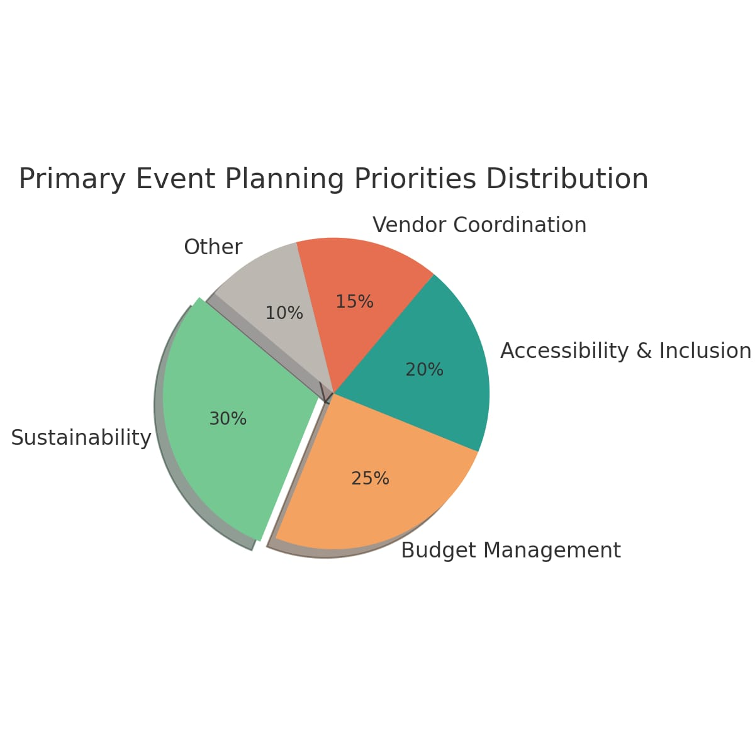
Requirement Gathering & Data Collection
Why Create an Event Management Website?
Our pie chart analysis is based on survey data collected through GOOGLE FORMS
It highlights various event planning priorities—sustainability, budgeting, accessibility, inclusivity, and eco-friendly practices.
Many users face challenges such as lack of awareness about sustainable practices, managing diverse needs, and resource limitations.
To address these, we propose Event Mate, a platform that offers:
Eco-friendly event planning templates & tools
Budget and Vendor management
Inclusive features for accessibility and cultural sensitivity
AI Event Planner to assist users with planning and execution
Conclusion: The platform will make event planning structured, inclusive, and environmentally responsible, helping users host events that are meaningful and mindful of the planet.

Slide 12
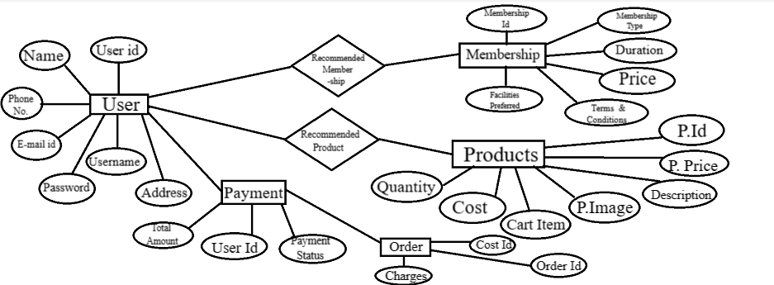
Design Phase : Entity Relationship Diagram

Slide 13
🔗 Multidisciplinary Approach
♻ Sustainable Event Planning : Eco-conscious event strategies, zero-waste guides, and green vendor recommendations to minimize environmental impact.
💰 Budgeting & Resource Management : Smart budgeting tools, cost calculators, and financial planning templates to optimize spending without compromising quality.
♿ Inclusivity & Accessibility : Guidelines and features ensuring events are welcoming to all—supporting accessibility, cultural inclusivity, and diverse participation.
🧠 Technology & AI Integration : AI-driven assistants, smart scheduling, and real-time communication tools for seamless planning and coordination.
📘 Education & E-Learning : Interactive modules and resources on sustainable practices, event ethics, and inclusive design to empower informed planning.

Slide 14
✨ Novelty Factor
⚖ Comparison with Others:
❌ Traditional Event Platforms = Basic listings & limited planning support
✅ Event Mate = All-in-one intelligent, sustainable solution
🧠 Smart Tools Beyond Basics : Unlike typical platforms, Event Mate offers AI-powered planning assistants, budget calculators, and real-time vendor coordination tools.
🛒 Integrated Eco-Marketplace : Built-in e-commerce for sustainable décor, reusable supplies, and accessibility tools—supporting eco-conscious and inclusive events.
📚 E-Learning Hub for Responsible Hosting : Educational modules on eco-friendly event practices, inclusivity, budgeting, and tech tools for holistic learning and growth.
🎨 Interactive UI & Visual Planning Aids : Features drag-and-drop timelines, visually intuitive layouts, and animation-enhanced modules for an engaging and seamless planning experience.

Slide 15
⚠️ Challenges Faced!
🔧 Complex Feature Integration : Bringing together modules like AI planning assistant, budget tools, inclusive design features, vendor management, and e-commerce in one cohesive platform was technically intricate.
⚙ Performance vs Animation Balance : Incorporating engaging visuals and interactive timelines while maintaining fast load times and smooth performance demanded careful front-end optimization.
💻📱 Responsive & Cross-Platform Design : Ensuring a seamless user experience across desktops, tablets, and smartphones involved extensive UI/UX testing and adaptive layout design.
🔗 API Integration Difficulties : Integrating third-party services for venue data, AI assistance, and marketplace logistics brought challenges in ensuring consistent data flow and real-time responsiveness.
🔒 Data Security & Personalization : Protecting user event details and preferences while delivering tailored recommendations required strong backend architecture and advanced encryption protocols.

Slide 16
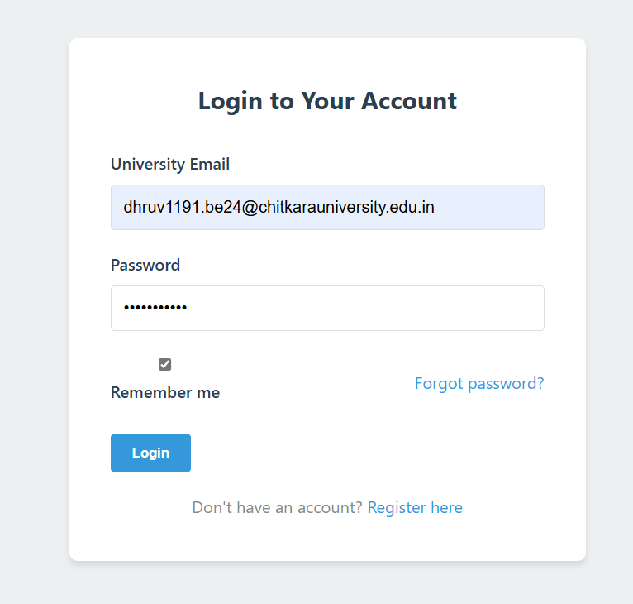
Login-Page
Login of the Fithub website displaying user interaction

Slide 17
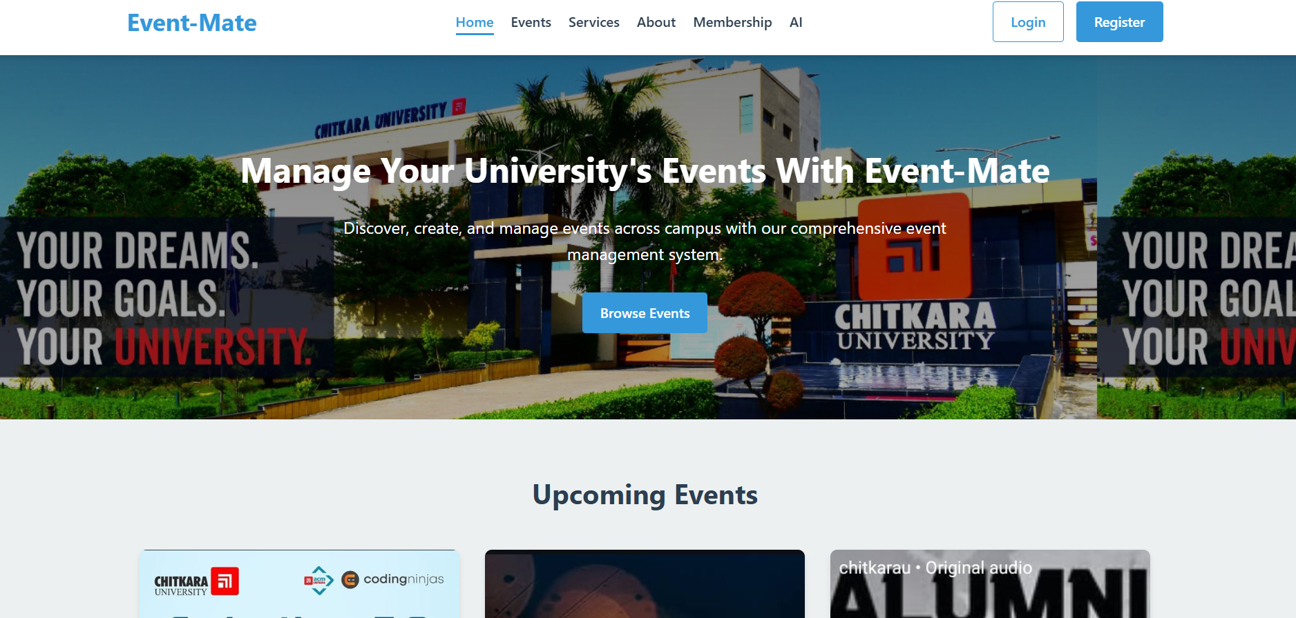
Main Page

Slide 18
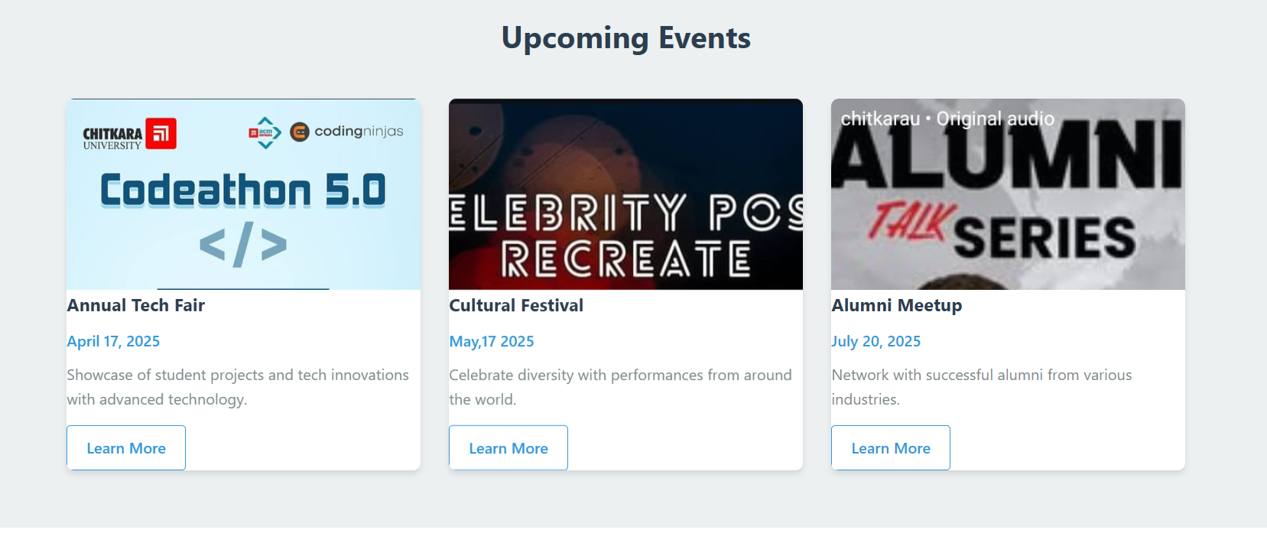
Upcoming Events

Slide 19
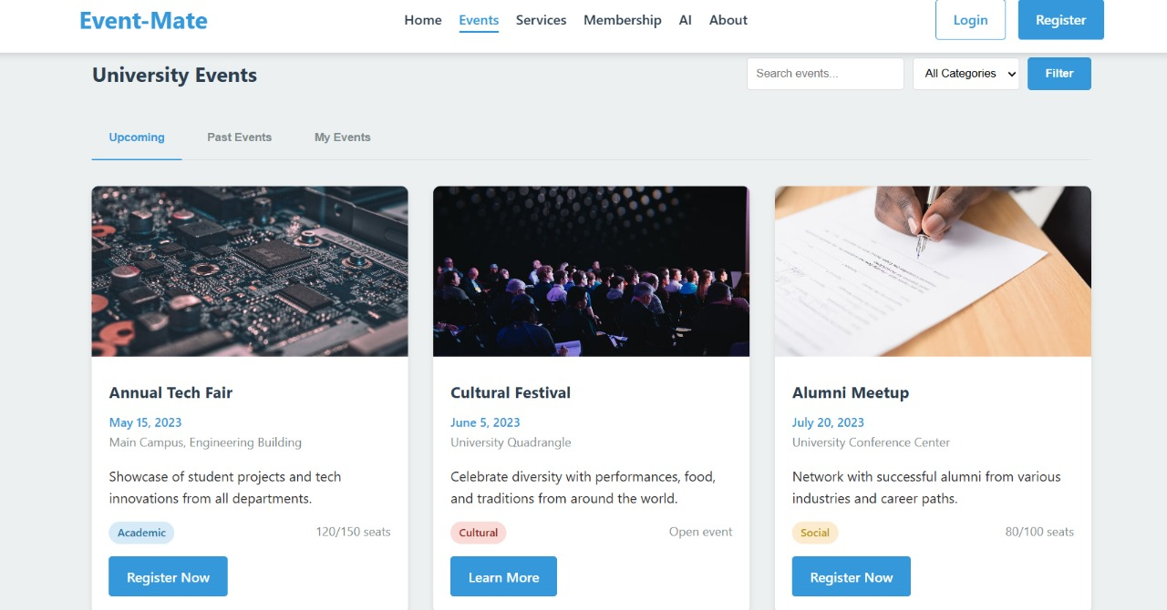
Events Details

Slide 20
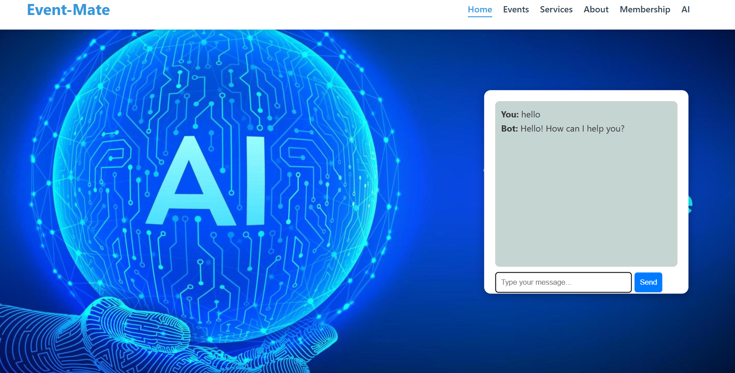
CHAT BOT
Ask by text—our chatbot answers all your workout-related queries instantly!

Slide 21
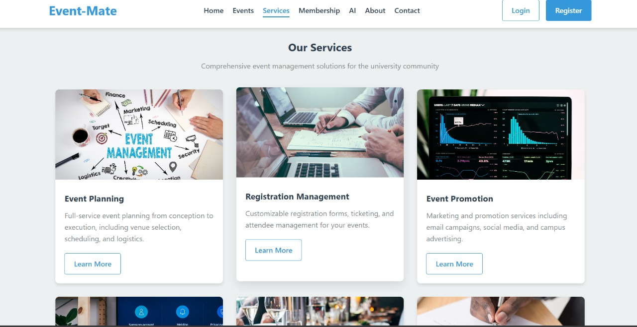
Services

Slide 22
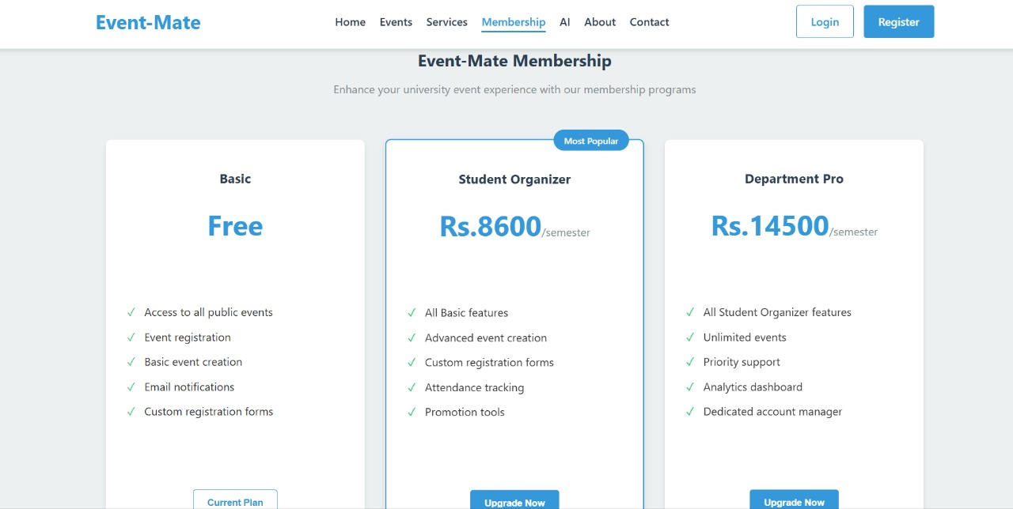
Membership Plans
Image showing interface of Supplements store

Slide 23
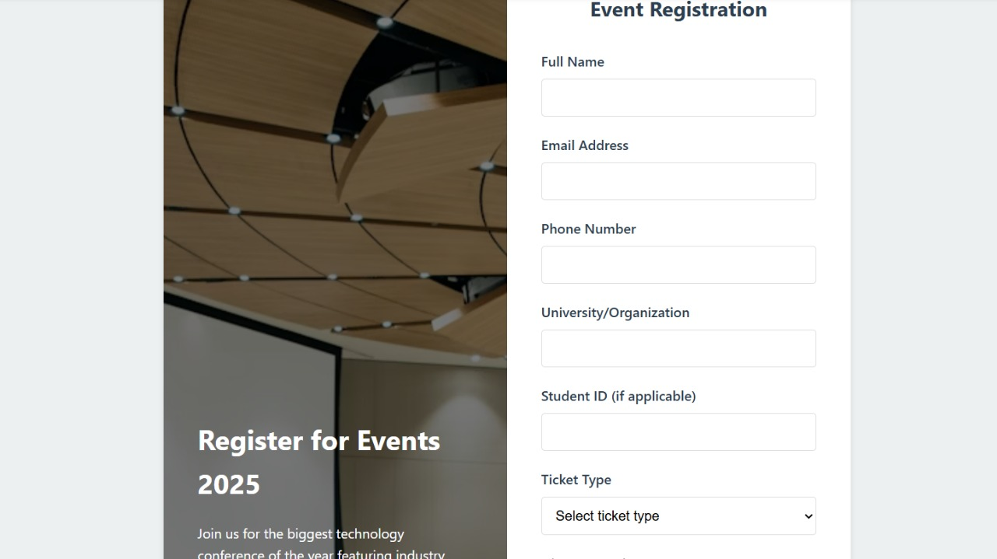
Event-registration Page

Slide 24
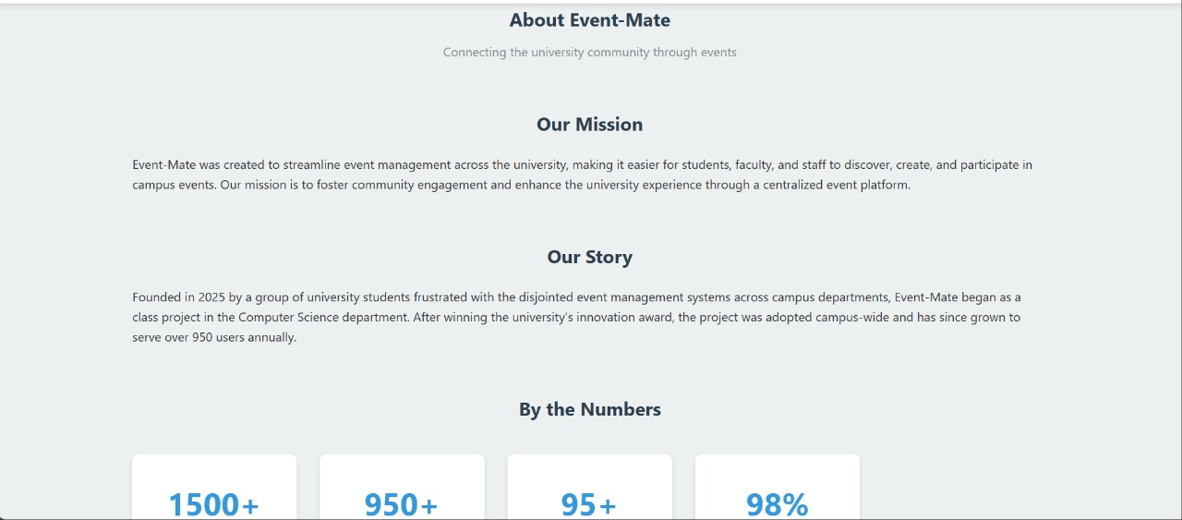
About Website

Slide 25
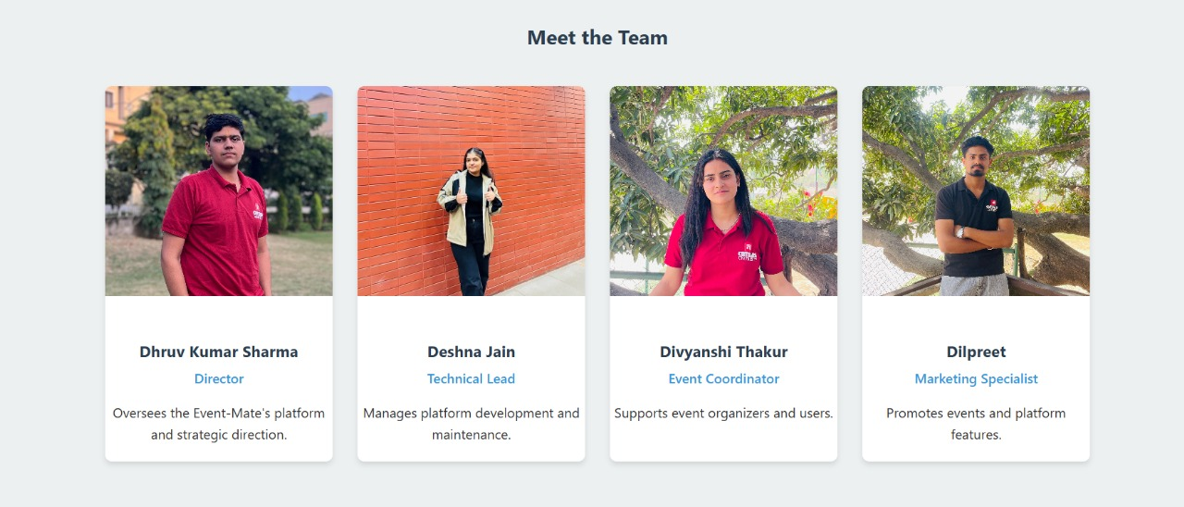
Team-Members

Slide 26
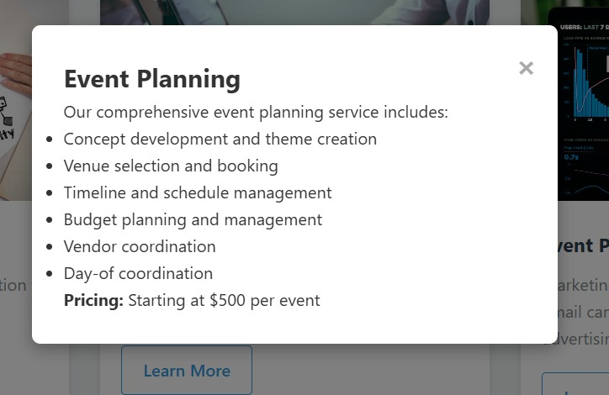
Details information of Planning
Image showing Creatine Products Of Fit Hub Store

Slide 27
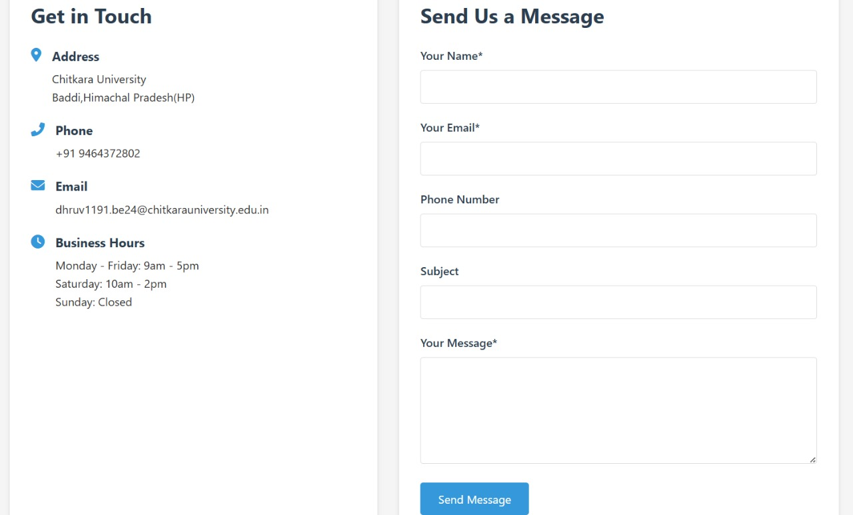
Contact-Us Page

